Slide 1
Informatica PowerCenter
Lesson 22: Metadata Tables and Views

Slide 2
Lesson Objectives
In this Lesson you will learn about:
  Metadata tables and views

Slide 3
What are Repository tables?
All objects that we create in Informatica Power Center (sources, targets, transformations, mappings, sessions, workflows, command tasks etc) get stored in a set of database tables.
These database tables are known as either Repository tables or metadata tables or OPB tables.

Slide 4
Repository Tables
OPB_TASK_ATTR - Task attributes tables
  This is the table that stores the attribute values (like Session log name etc) for tasks.
OPB_WIDGET - Transformations table
  This table stores the names and IDs of all the transformations with their folder details
OPB_WIDGET_FIELD - Transformation ports table
  This table stores the names and IDs of all the transformation fields for each of the transformations.
OPB_WIDGET_ATTR - Transformation properties table
  This table stores all the properties details about each of the transformations
OPB_EXPRESSION - Expressions table
  This table stores the details of the expressions used anywhere in PowerCenter.
Notes:
OPB_TASK_ATTR - Task attributes tables
Usage: Use the ATTR_ID of this table to that of the ATTR_ID of OPB_ATTR table to find what each attribute in this table means. You can know more about OPB_ATTR
table in the next paragraphs.
OPB_WIDGET - Transformations table
Usage: Use WIDGET_ID from this table to that of the WIDGET_ID of any of the
tables to know the transformation name and the folder details. Use this table in
conjunction with OPB_WIDGET_ATTR or OPB_WIDGET_EXPR to know more about
each transformation etc.
OPB_WIDGET_FIELD - Transformation ports table
Usage: Take the FIELD_ID from this table and match it against the FIELD_ID of any
of the tables like OPB_WIDGET_DEP and you can get the corresponding information.
OPB_WIDGET_ATTR - Transformation properties table
Usage: Use the ATTR_ID of this table to that of the ATTR_ID of OPB_ATTR table to
find what each attribute in this transformation means.
OPB_EXPRESSION - Expressions table
Usage: Use this table in conjunction with OPB_WIDGET/OPB_WIDGET_INST and
OPB_WIDGET_EXPR to get the expressions in the Expression transformation for a
particular, mapping or a set.

Slide 5
Repository Tables
PB_ATTR - Attributes
  This table has a list of attributes and their default values if any.
OPB_COMPONENT - Session Component
  This table stores the component details like Post-Session-Success-Email, commands in Post-Session/pre-Session etc.
OPB_CFG_ATTR - Session Configuration Attributes
  This table stores the attribute values for Session Object configuration like "Save Session log by", Session log path.
Notes:
OPB_ATTR - Attributes
You can get the ATTR_ID from this table and look it up against any of the tables where you can get the attribute value. You should also make a note of the ATTR_TYPE, OBJECT_TYPE_ID before you pick up the ATTR_ID. You can find the same ATTR_ID in the table, but with different ATTR_TYPE or OBJECT_TYPE_ID.
OPB_COMPONENT - Session Component
Usage: Match the TASK_ID with that of the SESSION_ID in OPB_SESSION table to
get the SESSION_NAME and to get the shell command or batch command that is
there for the session, join this table with OPB_TASK_VAL_LIST table on TASK_ID.
OPB_CFG_ATTR - Session Configuration Attributes
This table stores the attribute values for Session Object configuration like "Save Session log by", Session log path etc.

Slide 6
Mapping and Mapplet Views
Mapping and mapplet views allow you to see the sources, targets, and transformations used in a mapping or a mapplet by folder in a PowerCenter repository.
These views also display properties of mappings and mapplets such as description, version and creation date, validity of the mapping or mapplet, and whether the mapping or mapplet is a shortcut.

Slide 7
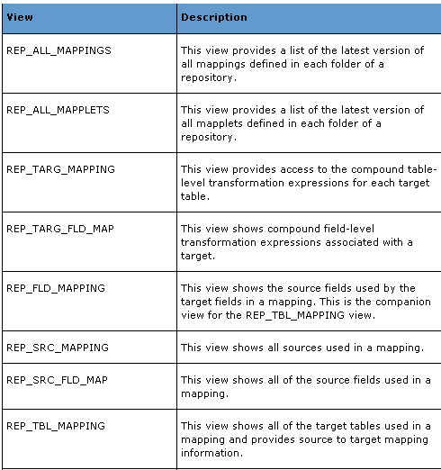
Mapping and Mapplet Views

Slide 8
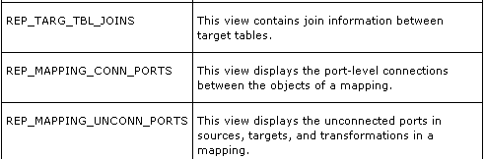
Mapping and Mapplet Views

Slide 9
Demo
Show Metadata Tables, Views, execute queries
Notes:
Steps to create a Lookup transformation:
In the Mapping Designer, choose Transformation | Create menu option. Select the Lookup Transformation. Enter a name for the lookup. The naming convention for Lookup Transformations is LKP_TransformationName. Click OK.
In the Select Lookup Table dialog box choose the lookup table. Click the Import button if the lookup table is not in the source or target database.
To manually define the Lookup Transformation, click the Skip button.
Define input ports for each Lookup condition.
For an Unconnected Lookup Transformation, create a return port for the value you want to return from the lookup.
Define output ports for the values you want to pass to another transformation.
Add the lookup conditions.
On the Properties tab, set the properties for the lookup.
Click OK.
For Unconnected Lookup Transformations, write an expression in another transformation using :LKP to call the Unconnected Lookup Transformation.

Slide 10
Summary
This Lesson gives knowledge about Metadata tables and Views

